Slide 1
What’s wrong with Baseball
By Ben Platt

Slide 2
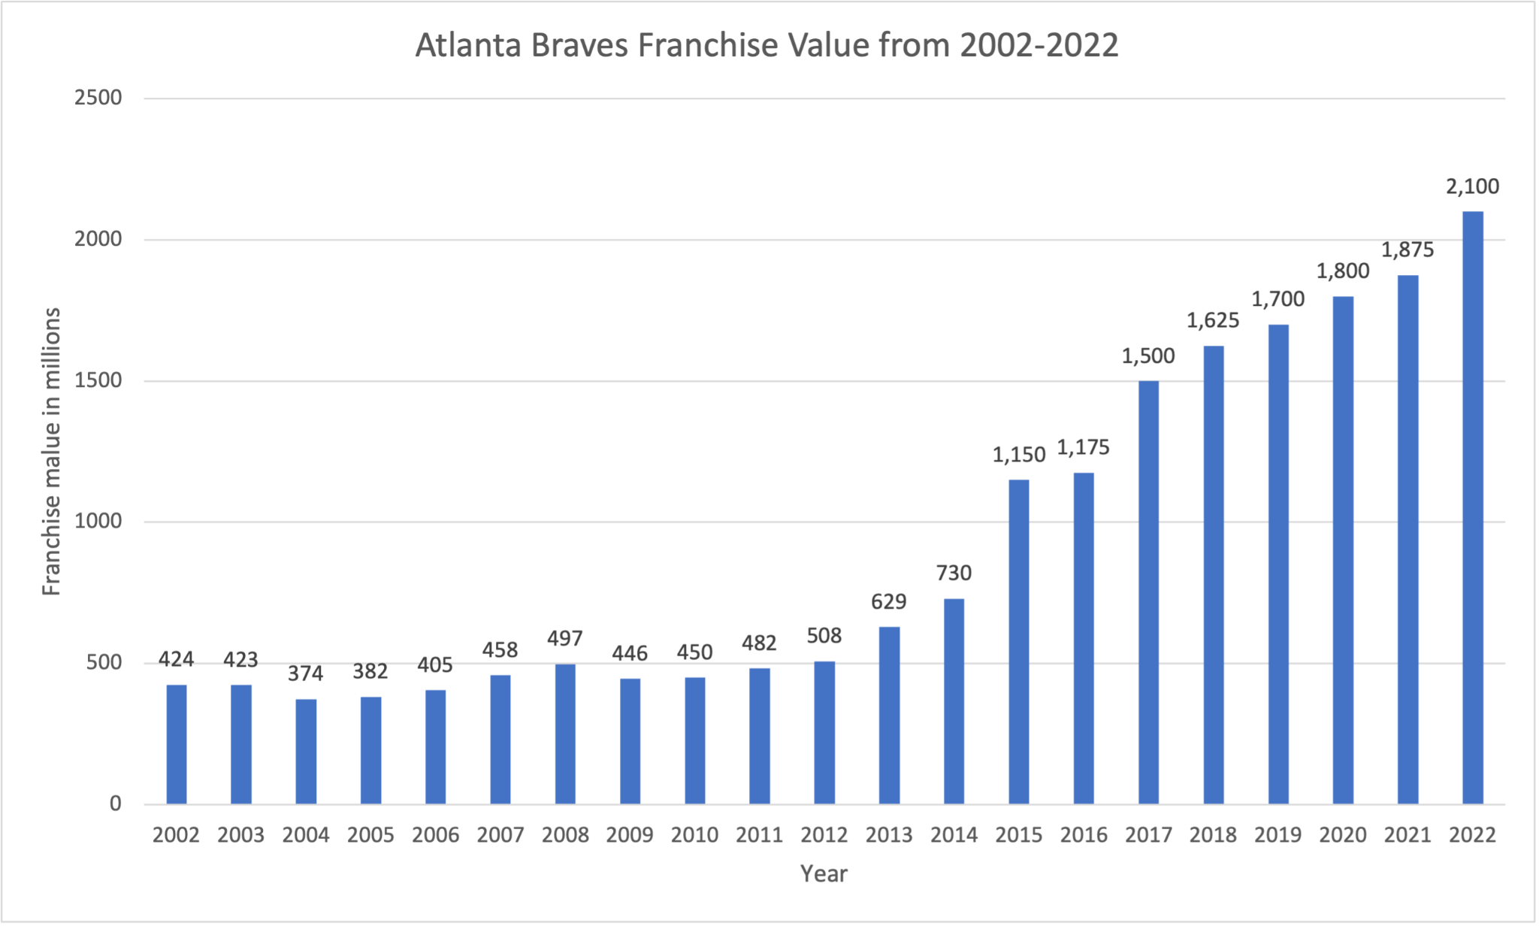
Atlanta Braves
Notes:
The current commissioner, Rob Manfred claimed that owning a baseball team is a worse investment than putting money into the stock market.
Not only is this a clear lie, but the truth is the almost complete opposite.
The Braves are one of two publicly owned franchises, because of that they have to release their financials each year. Unlike other teams.
It’s hard to judge these financials, mainly because we can’t compare them to the rest of the teams but you can get a rough idea of what's successful and what's not.
They also just won the World Series which generously skews the financials given all the money that comes in during the playoffs, especially when you win it all.
They also had much more lax COVID restrictions allowing them to let in more fans faster. They made about $50 million more that the average teams did in stadium revenue, and about $10 million more from playoff games.
Overall they probably made about $40 million more than the average team, but this is hard to make a fact.
Like all teams they lost money in 2020.
This does still show a picture of the health of a major league franchise.
In what the Brave’s call ‘baseball revenue’ they brought in $526 million just in 2021.
This would include ballpark revenue (tickets, concessions, retail, and suites/boxes), local tv and radio rights, and shared MLB revenue from broadcast and licensing rights.
Made $62 million in cash flow on operating activities
Spent $25 million on investing activities
Brought in $22 million from financing activities. Simply issuing debt.
In previous years they had more financial flexibility due to a normal environment.
All teams will dump their excess profits into ventures or improvements, this increases their franchise value without the need of cash profit.
They spent $457 million
$377 million in operating expenses
$80 million in “selling, general, and administrative expenses”
Franchise value graph
2002-2022
This graph shows the total value of the franchise for each year since 2002
Pretty much been going up since 2002 and especially in the past 5+ years
The gap between 2021-22 is more than $200 million in one year

Slide 3
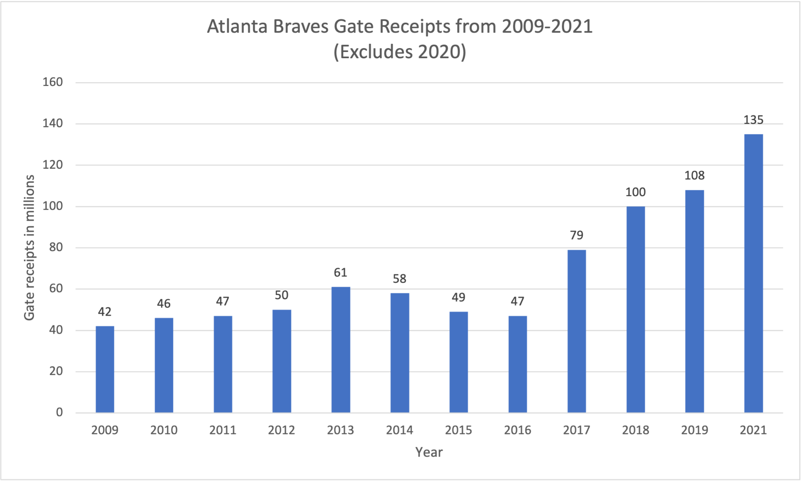
Braves continued
Notes:
Gate receipts graph.
Ticket revenue in millions from 2009-2021 (excluding 2020)
This just shows the amount of revenue coming in from tickets
Spike in 2021 was mainly because of lax COVID restrictions and a good team
Pretty clear trend with the success of the team and the ticket sales.

Slide 4
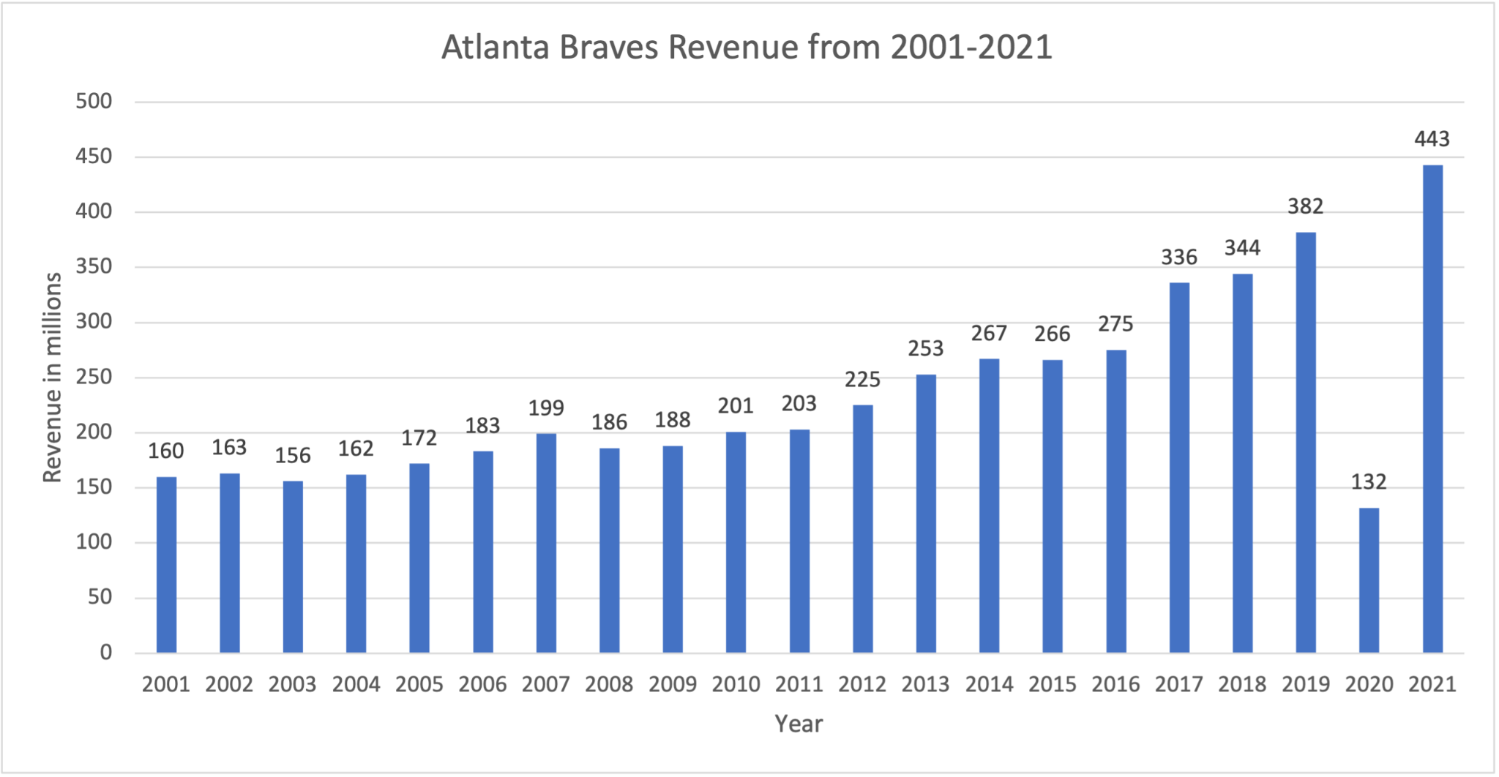
Braves continued
Notes:
Overall revenue from 2001-2021 in millions of dollars
Shows cumulative revenue from 01-21
Huge dip in 2020 but immediately surged past any of previous years
Like others clear trend of growth
Bringing that much in the first real season back is very impressive, again boosted compared to other teams given the lax COVID restrictions

Slide 5
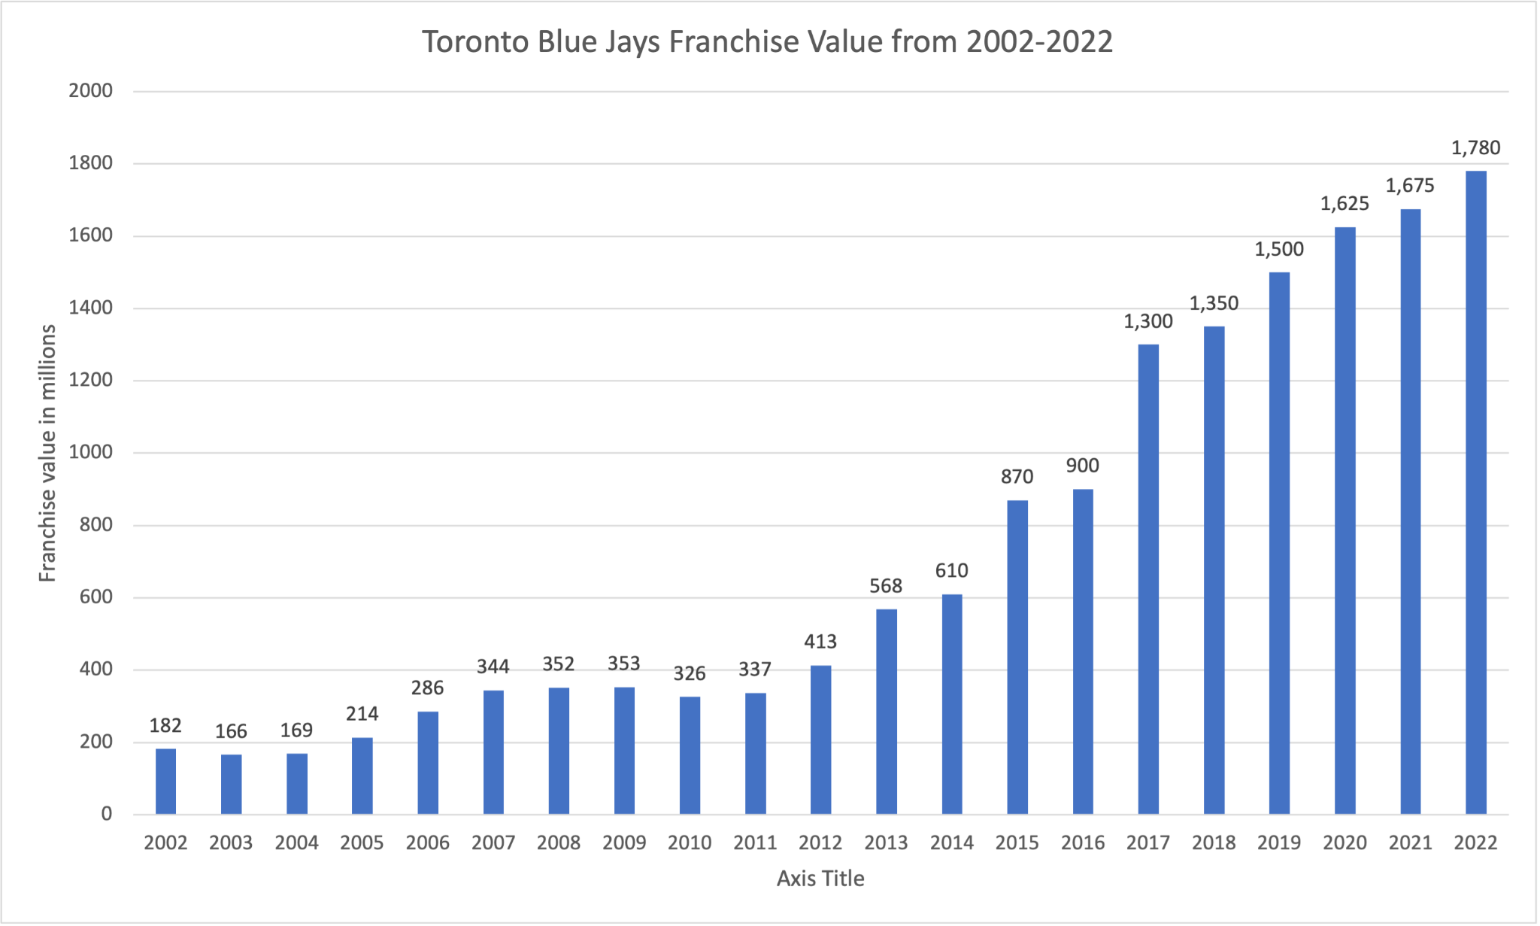
Toronto Blue Jays
Notes:
The Blue Jays are the other team that shares their financials.
Because of various reasons, one is them being owned by a canadian company and some other things make their release of financials even more vague compared to the Braves.
So not much to talk about or show for the Blue Jays
Franchise value from 2002-2022 in millions of dollars
Much steeper incline in growth compared to the braves. Both in similar team positions, both have great young players and are world series contenders.
Isn’t close to the braves last year but Canada had really strict COVID rules, Blue Jays didn’t even play in their home stadium for a while, instead in a minor league stadium in Bufallo, NY.

Slide 6
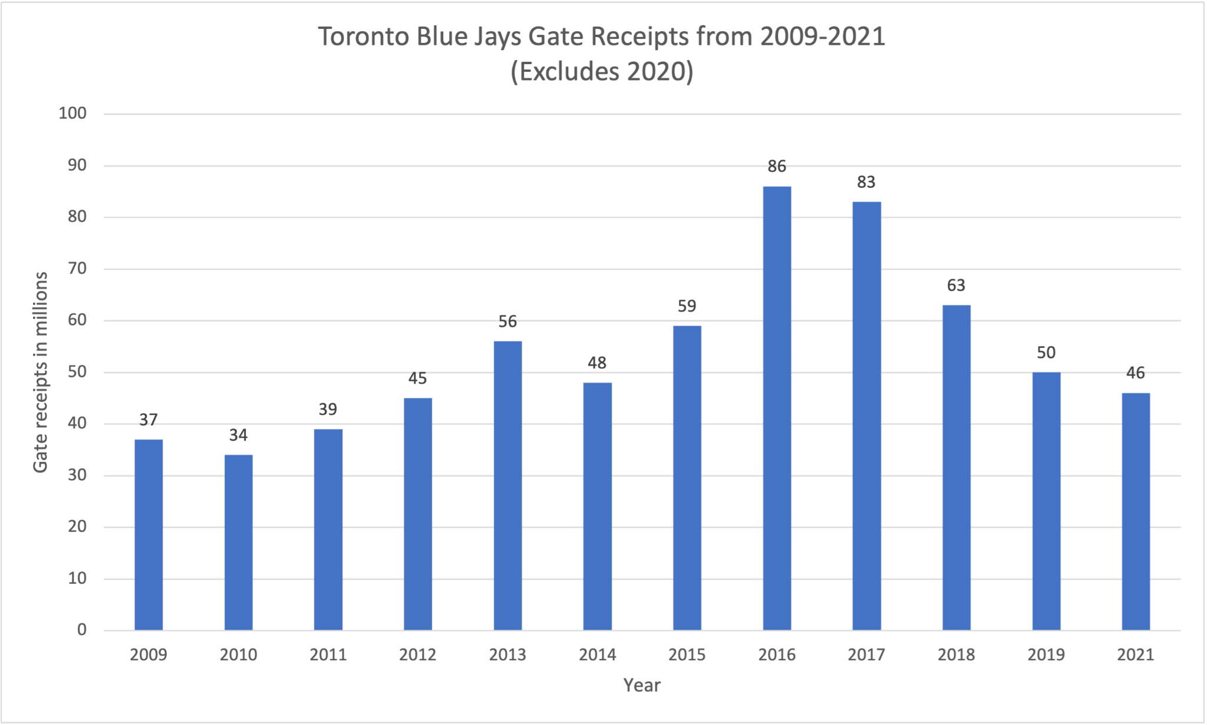
Blue Jays continued
Notes:
Gate receipts in millions from 2009-2021 (excludes 2020)
They had a spike when they were pretty good for a few years, this should come back up given their return to strength
They had spikes when they last had a playoff team.
The decrease is due to the not having a playoff team till about 2020 then not being able to get tickets revenue plus playing in a minor league stadium.

Slide 7
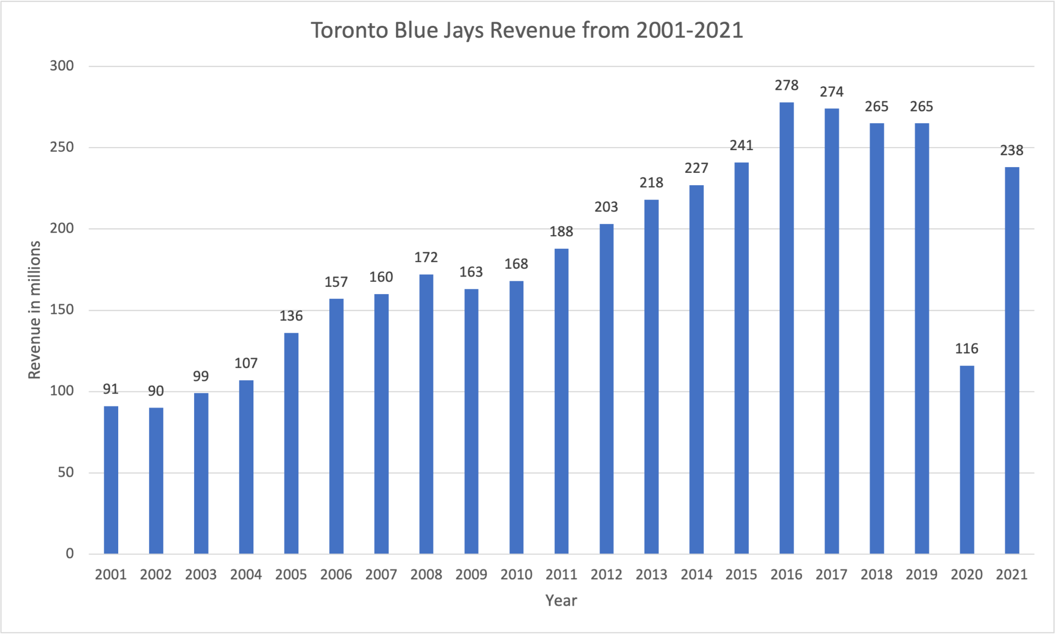
Blue Jays continued
Notes:
Revenue from 2001-2021
Massive dip in 2020, spikes back ip again in 2021, impressive given they spent a lot of time in a minor league stadium with no revenue and still almost matched previous playoff years revenue in normal environments.

Slide 8
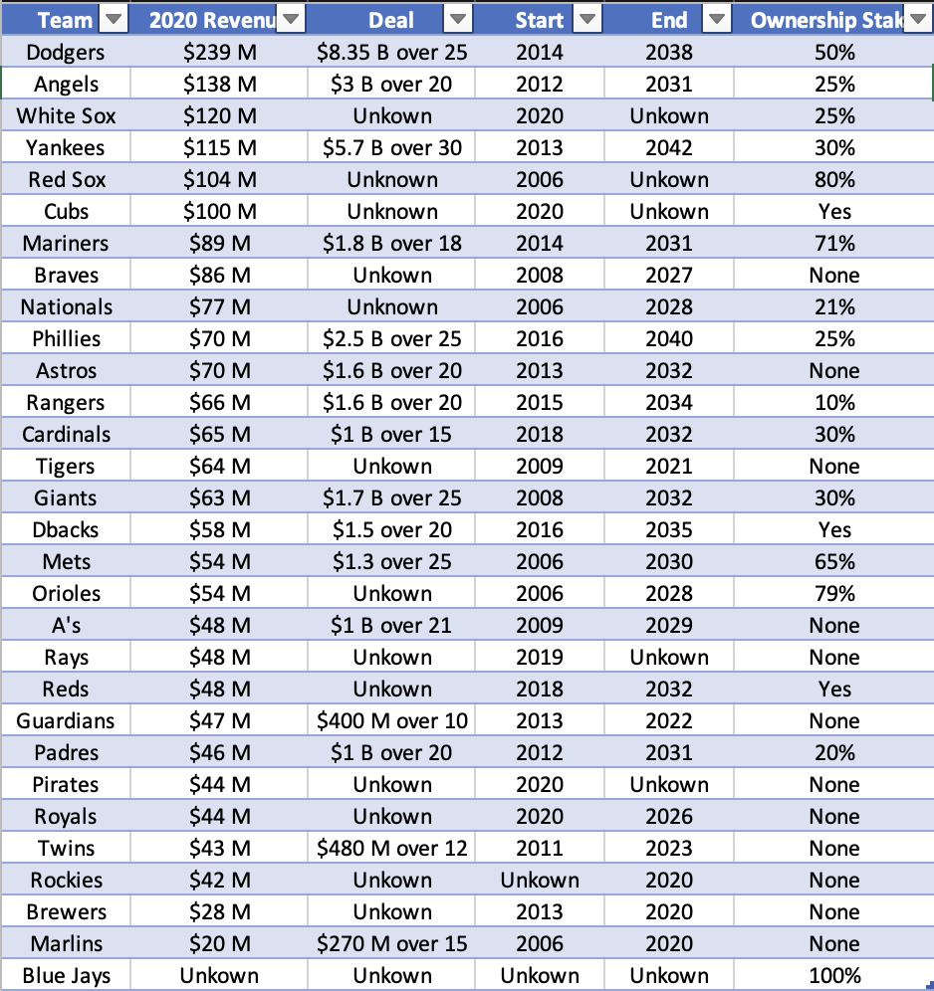
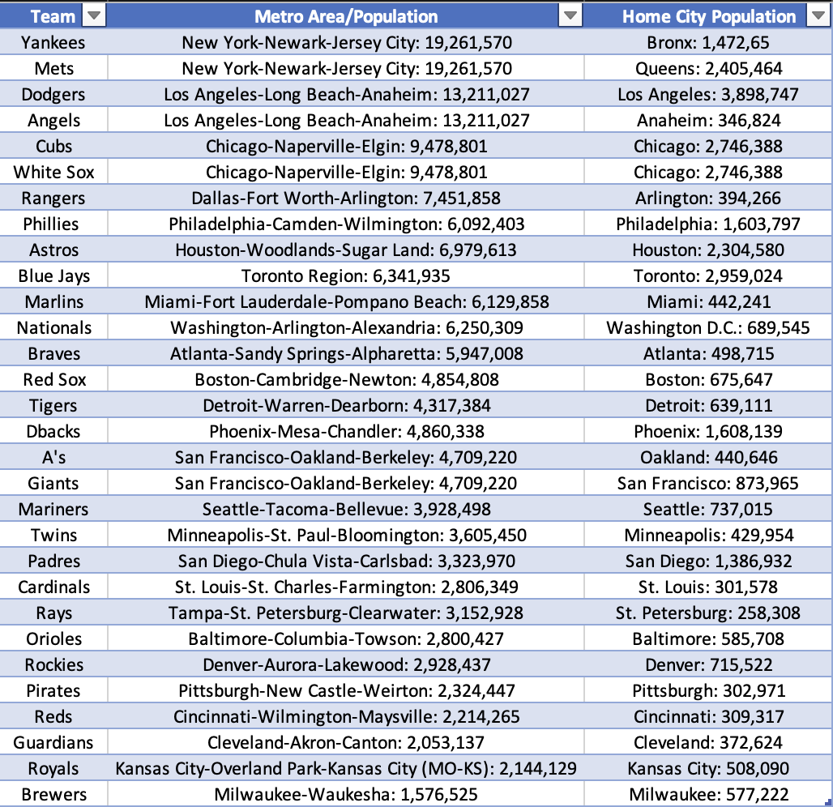
TV Contracts & Market Size
Notes:
Table of TV deals
These aren’t as correct as the direct financial statements but they come from one of the more reliable sources for basbasell info, FanGraphs
Some team contracts are unknown or partially
Basically teams aren’t getting overflowing pockets from their deals but they give an idea of how much money they have coming in just based on their team playing.
Table of market size
This table show the size of the metro area and home city for a reference to their market size and how that impacts production and popularity
Very clear that the smaller teams that spend less money and have less fans are toward the bottom and the bigger teams that are “supposed” spend are at the top
Teams like my Cubs are at the top of these lists but for as long as I can remember they act and think like they are a much smaller market team than they are
Teams like the Yankees and Dodgers do the opposite, they spend money and take advantage of their market and tv deals.
You can look at these tables and say with low confidence that fans should expect the top third or quarter of teams on this list to spend and act like a big team.
Smaller teams get their exceptions but if you teams like the Cubs shouldn’t get any slack.
This is a good example for why we need a salary floor.

Slide 9
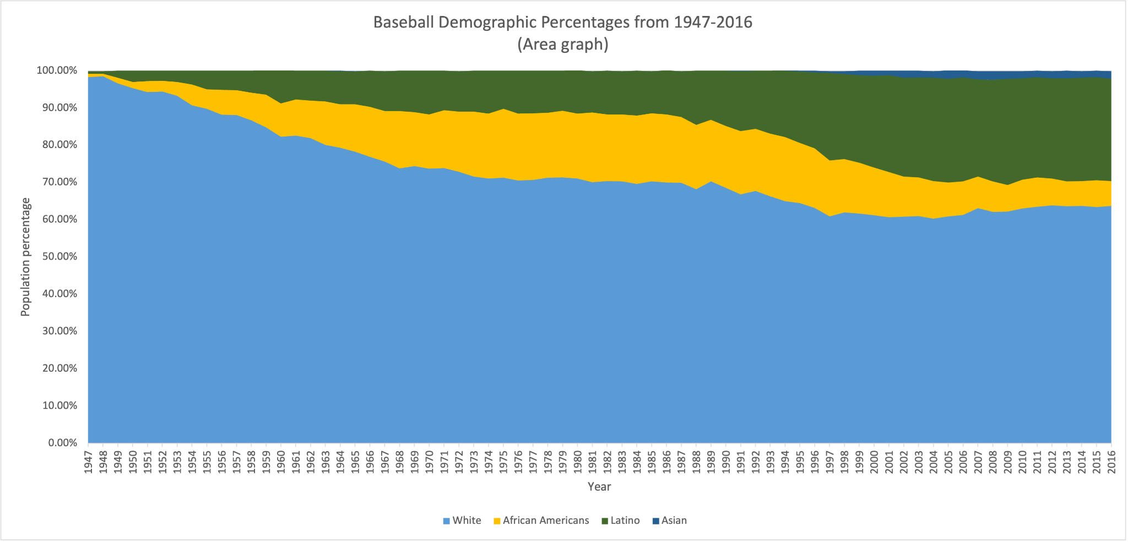
Baseball demographics
Notes:
How does this happen:
Sport changed into a less atheltic sport and drew less interest
Very expensive and hard to get into
Hard to practice by yourself
NCAA D1 gives 85 football, 13 Basketball, and 11 baseball gets all to cover around 35 players. Basically not easy to get a scholarship playing baseball.
Only 4% of NCAA baseball players were black.
Also affects coaching staff, front office, and press
In 2020 there were only 6 black reporters that mainly covered baseball
There has been improvement to all coaching areas except the manager position
Used to be 33% in 2009 now down to 20%
Institute for Diversity and Ethics in Sport (TIDES) at university of Central Florida makes a MLB racial and gender report card.
Racial hiring: B+
Gender hiring: C
Overall: B
Previous grade was B-
The league's office is at 37.5% people of color and 40.1% women, which is similar to the NBA.
The card covered CEO/President for the first time
Racial and gender hiring: F
39 of 40 known majority owners are white men
GM/Pr.BO got a C-
Same issue for women
Bright side: Kim Ng became the Marlins hired her as the first female GM ever.
28/30 teams have at least one woman in the role of VP or above.
Demographics area graph
Explain key, show how it was expanding than tightened again
Massive latino spike
Latino and African-Americans were sort at equal pace when Lation spike and continued to grow while the African-American population went way down.
Asian also started to grow compared to how hard it is to see on the graph

Slide 10
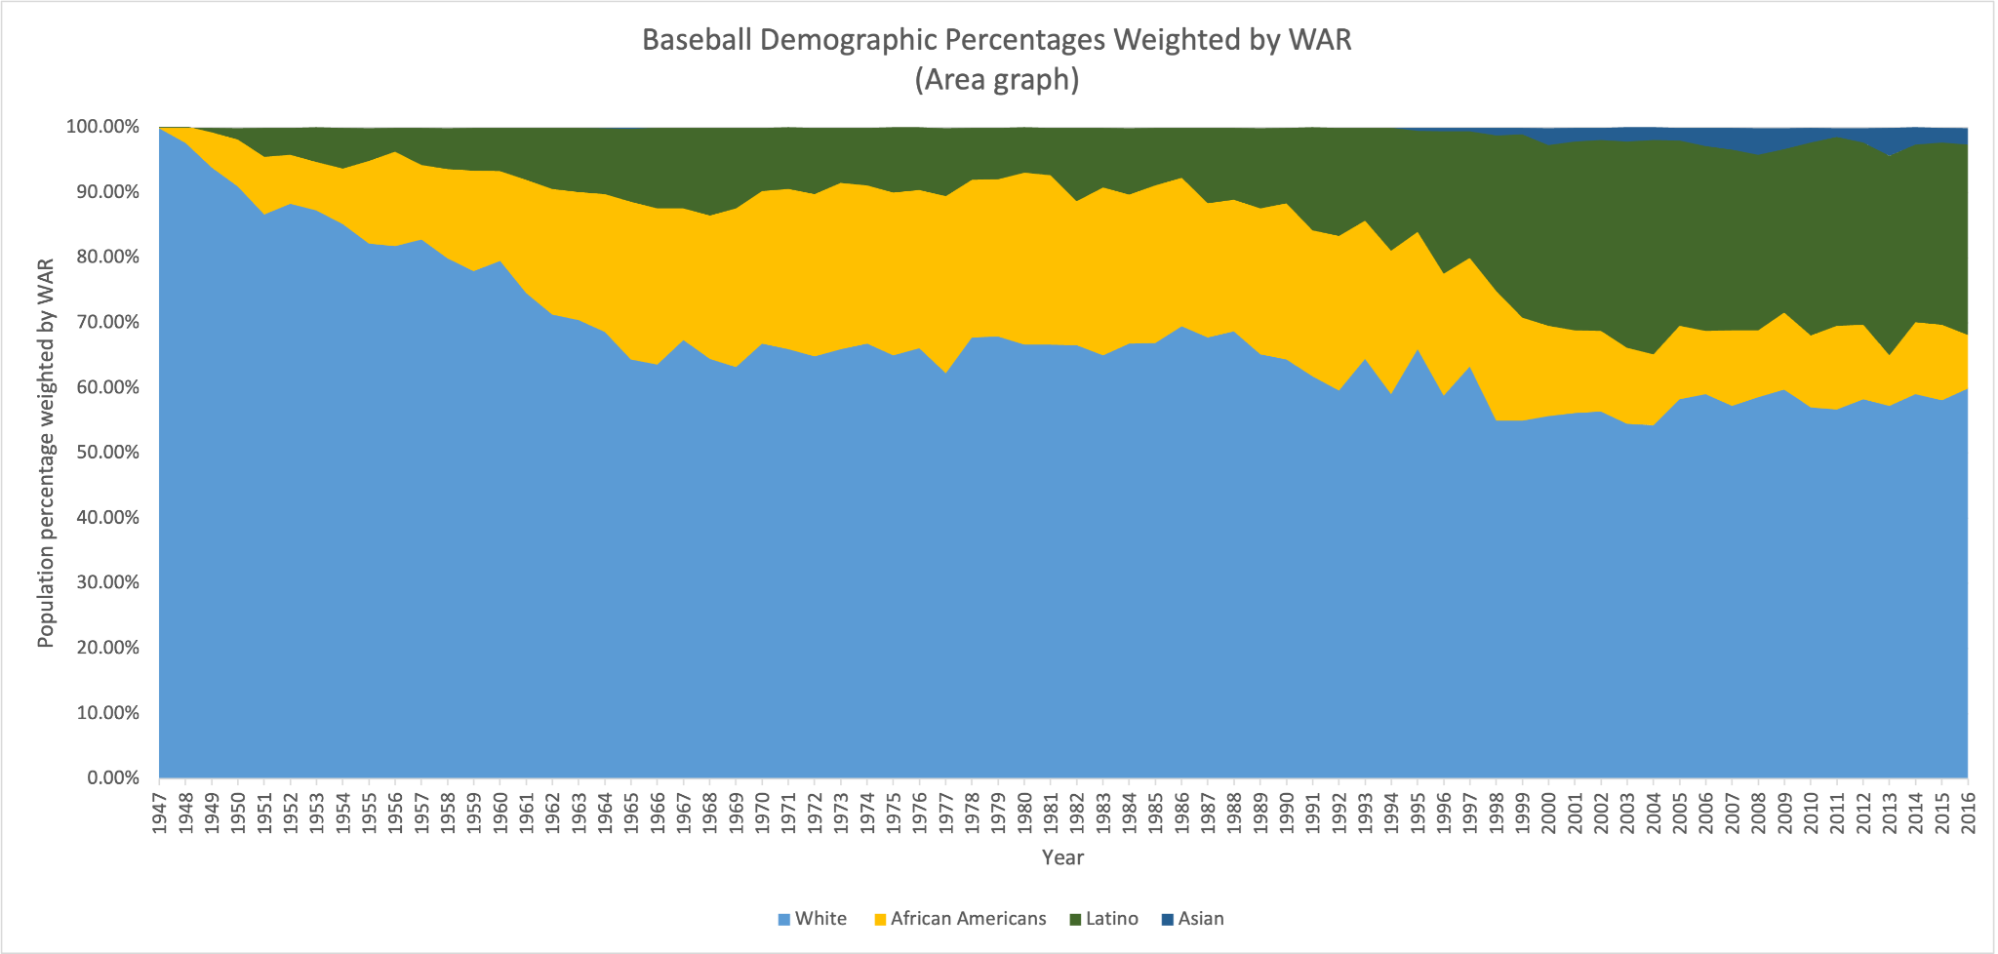
Baseball demographics continued
Notes:
Same graph as the last just instead this one weights the demographic population by their cumulative WAR to get a better idea of the impact each demographic has.
WAR: Wins Above Replacement, WAR is one of the most popular stat used in sabermetrics. Its goal is to try and put a number value on a players performance as a whole. It’s not supposed to be incredibly accurate or used on its own like other stats, its best used in unison with other stats to create bigger picture. In this situation it works really well because of how good it is at quantifying player value.
What mainly stands out is the noticeable increase in size for African AMericans compared the other graph. SImply what that means is that African American players have been a lot more productive and impactful than the demographic says. Even makes the smaller section from the more recent years look bigger.
Same goes for latino players, a clear increase in size.

Slide 11
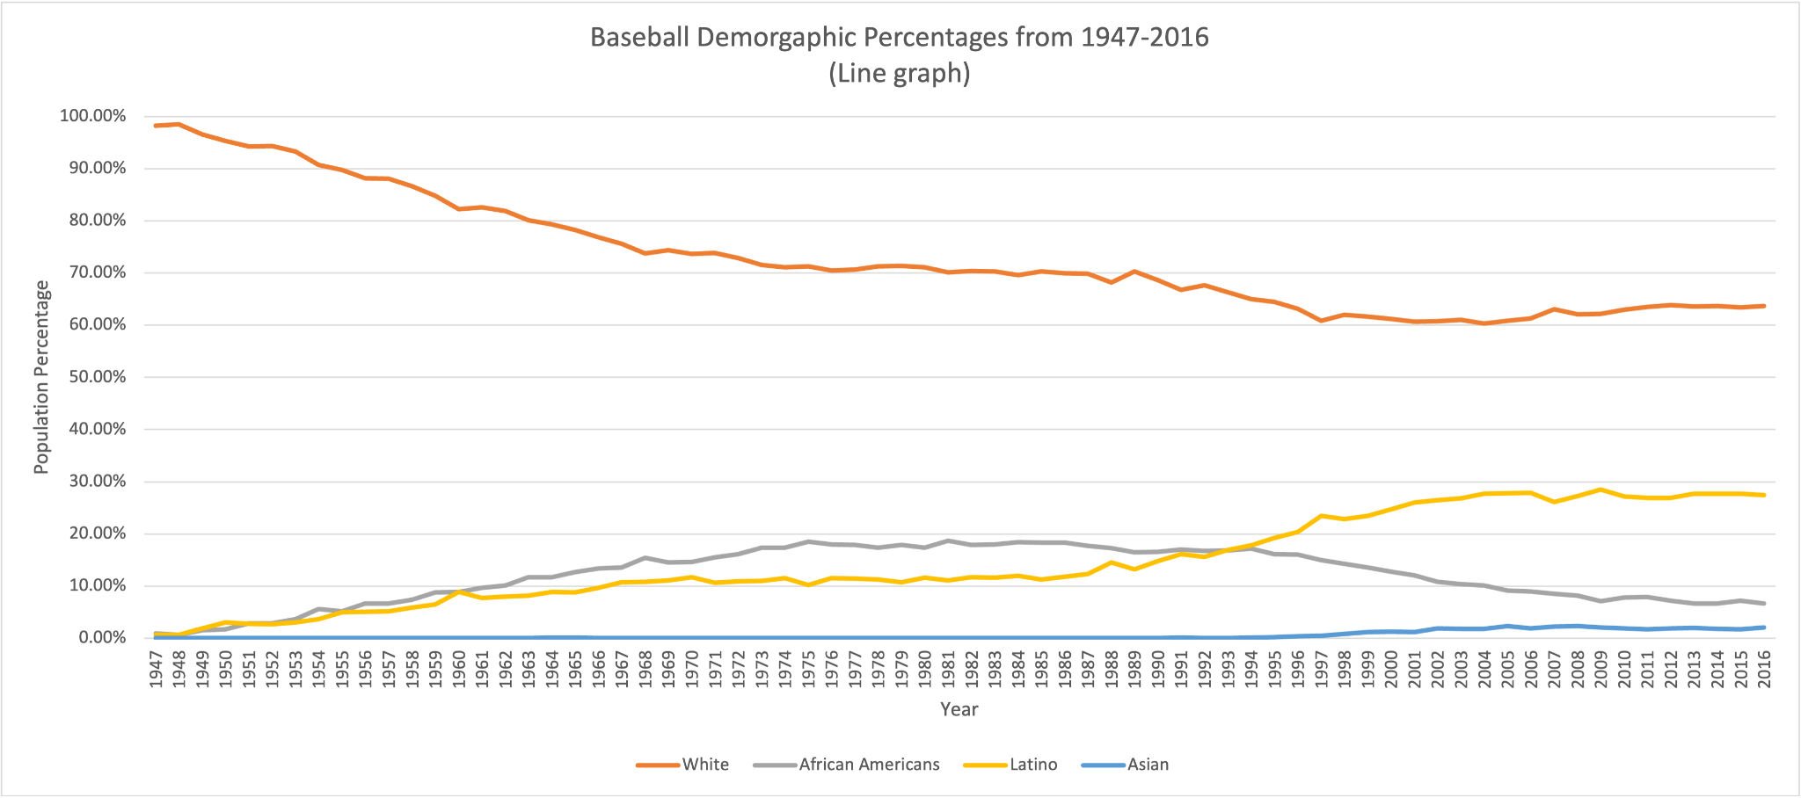
Baseball demographics continued
Notes:
Same data as first demographic graph
This just makes it easier to see the trend or path of each demographic over time.
The white population has slowly gone down, makes sense with the influx of more international players.
African american was steadily increasing during the 70s and then started to slowly go back down to what looks like a close low to the beginning of the graph.
Latino spike through the african american population and plateaued a little bit but doesn’t seem to be dropping.
Asian population also starting go up.

Slide 12
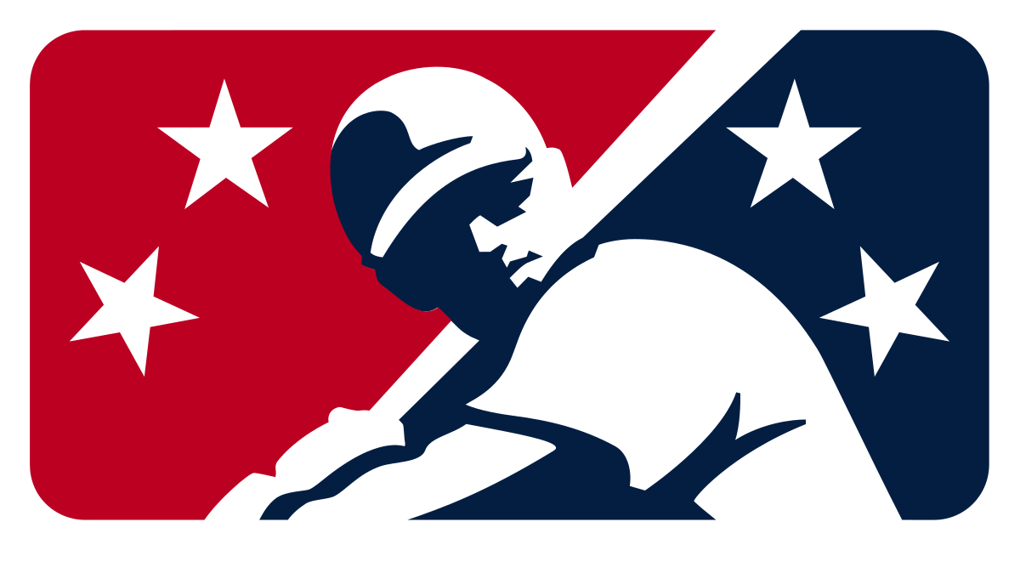
MiLB and service time issues
Notes:
Another reason not to pursue baseball after high school or collegea
Terrible conditions unless you were a high draft pick
To get to the majors on average its 4-5 years for college players and 5-6 for high school players)
Usually worse for foreign born players except some that get multi million dollar signing bonuses.
Living in one small apartment/hotel with other teammates or living in your car.
Only getting paid seasonally
Have to work during the offseason while staying in shape and practicing.
Hard to find work for short amounts of time.
Hard to find good housing for short periods of time.
Not a lot of players speak out due to fear of career being affected
MiLB players make about $10-$15,000 annually and MLB players made $570,000 annually in 2021
NHL pays their mls $51k a year and NBAs G-league $37k a year, both are more than double the Triple-A annual salaryhh
Guys go play winter ball in the dominican and they pay them $10k a month, provide a rental car, housing, and food.
MLB has antitrust exemptions, making it almost impossible to force the league to make any changes.
Minor league players are exempt from the federal minimum wage and overtime rules.
Teams are now required to provide housing for all players
Has its problems/loopholes like making some of the housing hotels instead of a house or an apartment.
Teams aren’t treating the players as investments instead as objects that have a chance of becoming valuable or get released at some point.
Service time issue
Poster boy is Kris Bryant
In 2015 the Cubs started KB at AAA to start the season, they delayed his promotion to the majors until 4/17 to gain an extra year of control.
He was promoted the day after the cut-off point that would have granted him free agency a year earlier.
Cubs said they kept him down to work on his defense, other teams have and are doing this with top prospects still.
Bryant and the PA eventually filed a grievance and lost but it was big step forward.
The system that is used to decide when a player becomes arb eligible or a free agent, it counts the days you play in the big leagues, 172 equals one year of service)
Holding down prospects can save teams millions by just extending their control of the player.
One of the only solutions besides getting rid of counting (if there is a counting system, it will be manipulated) is making it not profitable to hold guys down.
The new CBA has some good changes
A player can come up from the minors at any point and if they finish 1st or 2nd in ROY they get a full year of service.
Teams can get extra draft picks if they promote their top prospects on opening day.
If a prospect finishes top 3 in ROY, MVP, CyY their team gets an extra draft pick after the first round.
This season 5 of the 25 top prospects were on opening day rosters.
A pre-arb pool was created. Best players in each position/class will get a bonus based on their performance. Top 100 (ARB) players via a WAR-based formula and the end of the year award (ARB) winners will split up a $50 million dollar pool annual.
Ex: Corbin Burnes led all pitchers in WAR last year, won the Cy Young but only got paid $608K because he is still in pre-arb. He would have gotten a huge bonus if it was this year. KB won ROY and then MVP in his sophomore season were he also would have garnered a large bonus. (Worked out for him in the end, he got a 7-year $182 M deal.)

Slide 13
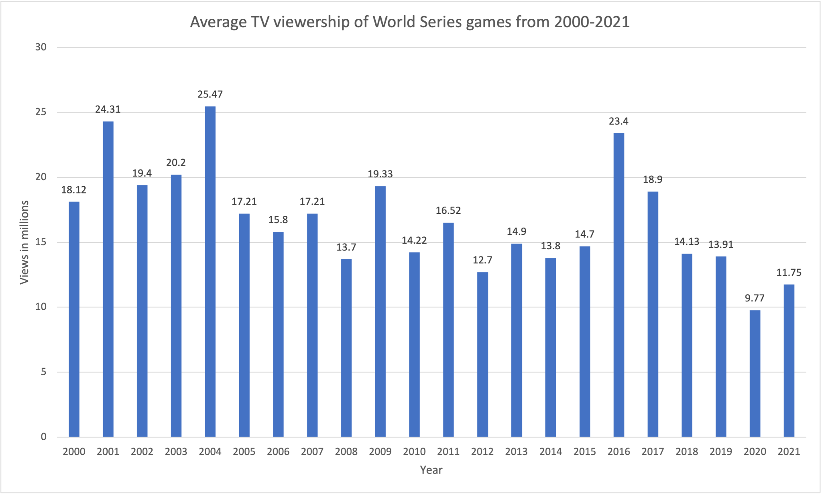
Marketing issue
Notes:
Marketing issue
According to SI in 2018 only 22% of the American public knows who the Millville Meteor or Mike Trout.
Best example I can give is that my mom has no idea who he is but know Lebron, Brady, Tiger, Messi, Ronaldo, and etc.
Trout doesn’t do many commercials or sponsorships outside of what the team requires him to do or the league. When you are getting paid like he is you don’t really need to do ads. The league like others should be able to market their players.
He also isn’t very flashy or have a very vibrant personality that draws a lot of attention.
In 2018 commissioner Rob Manfred said “Mike is a great great player, and a really nice person, but he’s made decisions on what he wants to do, doesn’t want to do, and how he wants to spend his free time or not spend his free time. I think we could help him make his brand very big. But he has to make a decision to engage. It takes time and effort.”
Another issue has to do with MLB as a whole, Trout plays for the LA Angels, a team in a large market that somewhat refuses to field a playoff quality team. During one of the only times where viewership is high the league's best player isn’t there. (Trout only has played in 3 playoff games, all in 2014)
Blackouts
You can’t watch every local team on tv unless you have the local broadcasters channel, it’s a nationally televised game or you are physically not in the region of that team. Hard for fans to watch their team without paying for an extra streaming service.
Less interesting draft compared to other professional sports.
College baseball doesn’t have nearly as much attention as basketball or football. Top college prospects don’t get the same national attention that basketball or football prospects do.
Because high school players can be drafted it makes it harder to know who is who when watching the draft. A lot harder to take interest in the draft when you don’t know anything about the players.
Unwritten rules
Most of these are leftover from the earlier days of baseball.
Don’t steal bases, swing 3-0, or run up the score when up by a large margin.
When losing by a large margin dont steal bases or pimp HRs.
Don’t show up your opponent (bat flips, HR tros, screaming after a K)
It’s ok to throw at a hitter if you have bad blood or they broke an unwritten rule.
There are plenty of others, most mild and some even that are good.
Funny one: Center field gets priority over balls hit in the gaps.
https://www.nbcsports.com/chicago/video/luis-robert-steals-jimenez-catch-eloys-face-says-it-all
A year later he tore his pec trying to rob a HR in ST, maybe this rule is good.
WS viewer numbers
Viewership has gone down which doesn’t follow the rest of society.
With the growth of the internet and streaming services it became easier and more common to watch sports, helping with the growth of most major sports.
There is a lone peak in 2016 when the Cubs won the World Series, probably the majority was fans from Chicago.
Otherwise it's gone down, it's not like it hasn’t had major contenders, the Dodgers, Astros, Red Sox, and Mets have been in the WS since 2015.

Slide 14
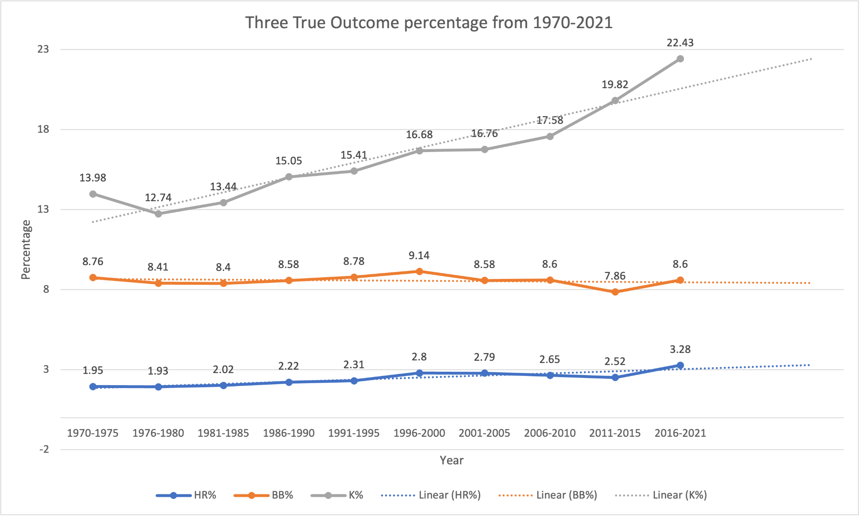
Three True Outcomes
Notes:
Three True Outcomes
TTO represents the current era of baseball. The majority of major league baseball has turned into this, every plate appearance is most likely to end up a walk, strikeout, or home run. Home runs are fun, there's nothing wrong with them but strikeouts are fun and walks are good but it gets old quickly. It was better when you got to see guys showing of their athleticism to make great plays in the field instead of waiting for a walk or K.
This has led a large majority of players into changing their approach in their at bats. There are more guys who have terrible batting AVGs but have really high OBP and SLG. Guys like joey gallo that literally only strikeout, walk, or hit a homerun. Stats said that it was good to hit home runs and walk but it ended making baseball boring.
This graph shows 2 things for each percentage, the data and a prediction.
Strikeout% is the most obvious, it just shoots up and we already know its not slowing down anytime soon. 22% is just insane, 1 in 5 PA will be a K, not very enticing to watch. Probably will go up even more and this doesn’t even represent the large group of players with 25% K rates.
BB% surprisingly has been more steady compared to the other 2 and hasn’t really changed much. It's actually gone down, which makes sense given the influx in strikeouts. Prediction also looks like it will continue to stay steady.
HR% is a little harder to look at because of how small of a number it is but it's definitely gone up. Primarily given how high it has been 5+ years even compared to the steroid era. That will likely keep going up until there is some change in rules potentially.

Slide 15
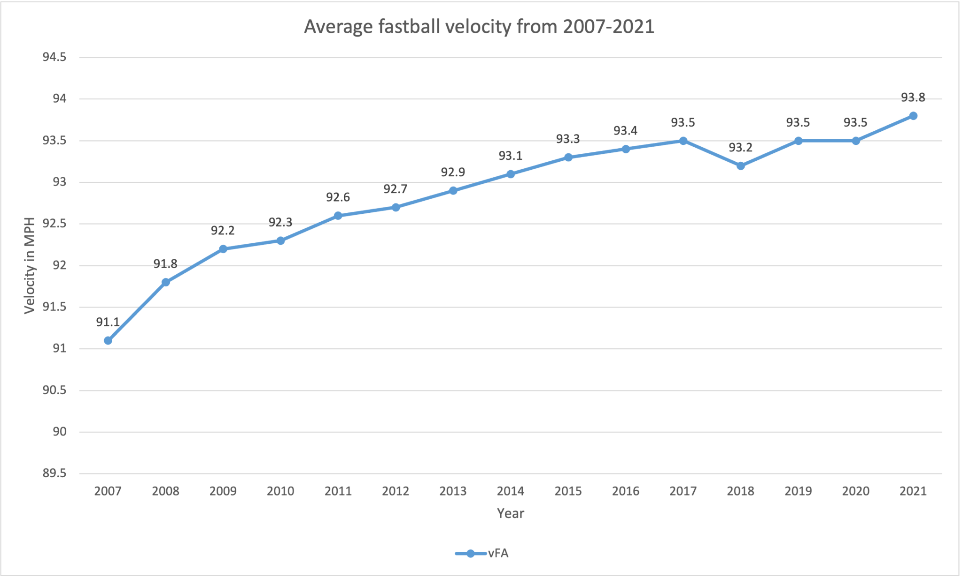
Fastball velocity
Notes:
Average Fastball Velocity
This has only been tracked since 2007 but it still shows a lot of change and its easy to imagine what the number would have been before 07.
This simply shows the average fastball velocity from 07-21.
Continuously gone up and doesn’t appear to be stopping.
There is nothing wrong with pitchers throwing harder, but it is part of a wide range of stats that show that pitchers are getting a lot better than hitters with their velocity and pitch design.
There is so much technology involved with pitching that it makes a lot of sense.
Higher velo leads to more strikeouts which leads to less balls in play and less fun.

Slide 16
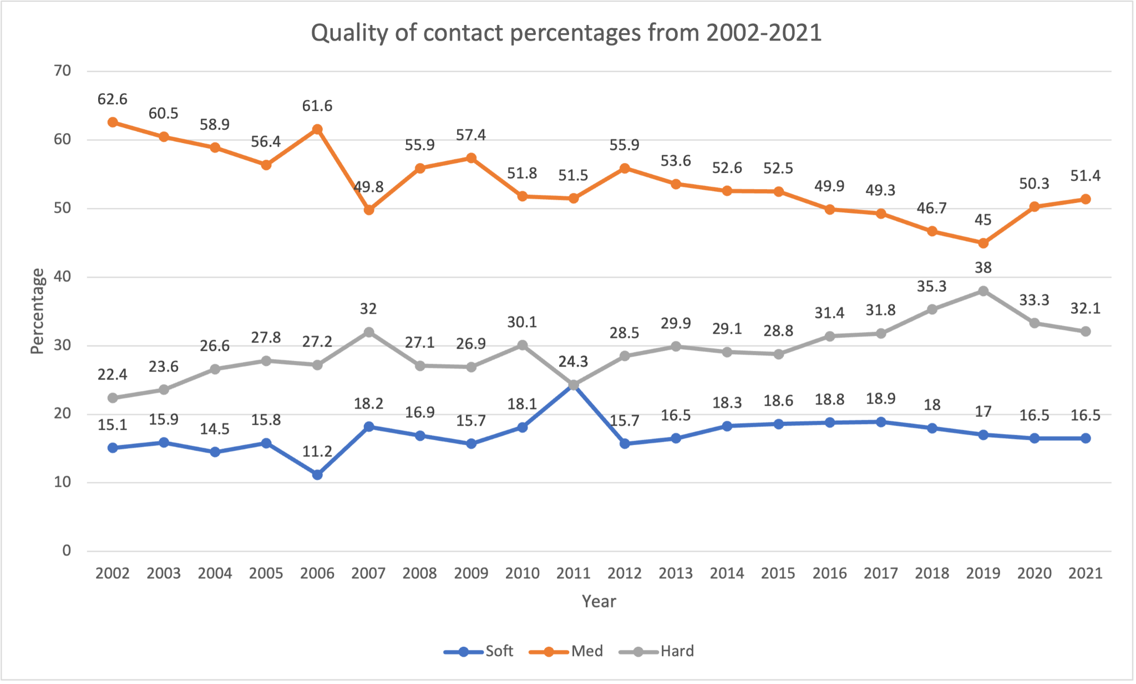
Quality of contact
Notes:
Quality of contact %s
Quality of contact consists of three stats. Soft, medium, and hard contact. It's a known fact in baseball that you have a much better chance of getting a hit it the harder you hit the ball.
This fuels the three true outcomes, guys just swing out of their shoes all the time and strike out or hit a homerun and some of time just hit hard lineouts.
Medium has gone down which makes sense, we are not in the small ball era where there was lots of light contact and more balls in play.
Soft has stayed pretty consistent especially this past decade.
Hard contact unexpectedly isn’t rare anymore and is still going up. Hard % going up or down doesn’t have a very clear correlation with the health of baseball. Going up could increase TTO and going down could decrease power. Both are good and bad in their own sense, the game will continue to move in that direction, striving for hard quality contact.

Slide 17
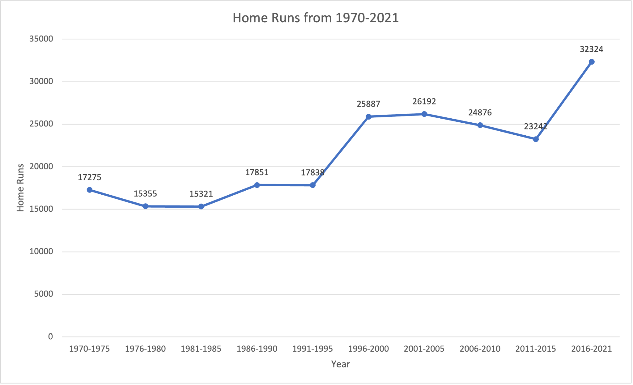
Cumulative home runs
Notes:
Cumulative home runs over the years
This is one of the better ways to show the power increase even though its a simple stat.
Very clearly there is the home run boost in the steroid era, a gentle decline and than giant spike up to now with the juiced and not juiced baseball.
Having the juiced balls in 2019 and maybe before does affect the home run totals but it's hard to give it all the credit. Like i said before guys are swinging out of their shoes more often than not just trying to hit the ball hard and that plus the mentality of trying to hit home runs has played a bigger role in the increase.
The current totals are above the peak of the steroid era by about 6000 home runs, most of that can just come from the baseball, its a joint effort.

Slide 18
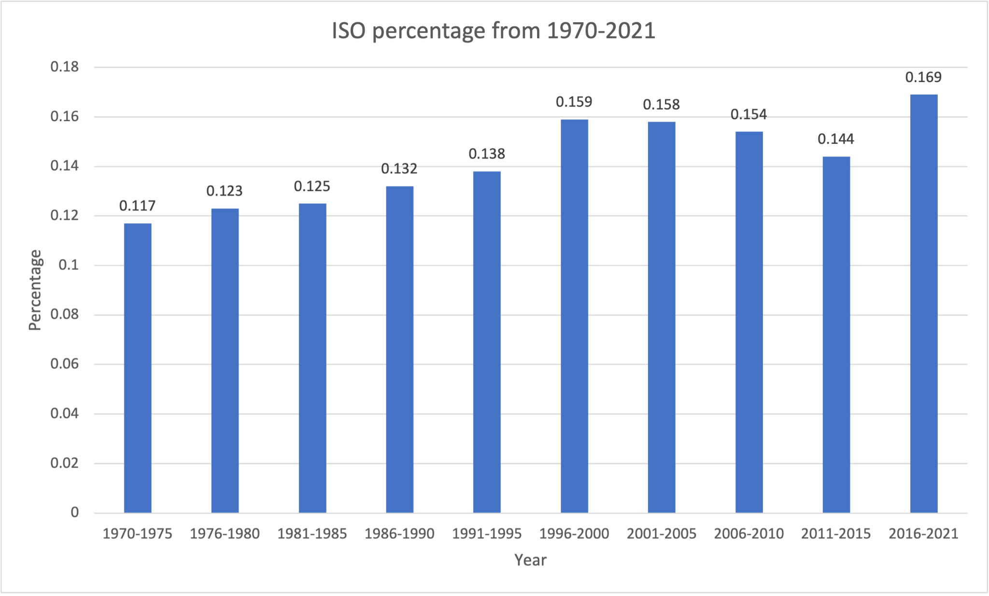
ISO (isolated power)
Notes:
ISO graph
ISO basically gives an image of a players raw power and how many extra bases they get per at bat.
ISO can help differentiate between stats that are closer together. Having similar AVG won’t correlate to OBP or SLG.
Iso mean isolated power, its similar to slugging in it just looks at a players power and no other factors.
It's hard to see the growth but similar to HR% the changes are in small increments that matter more than they look.
Even with the small increases the past 6 year AVG is higher than 1 hundredth above the last peak in the late 90s early 00s.
Most likely will continue to go up along with other power stats.

Slide 19
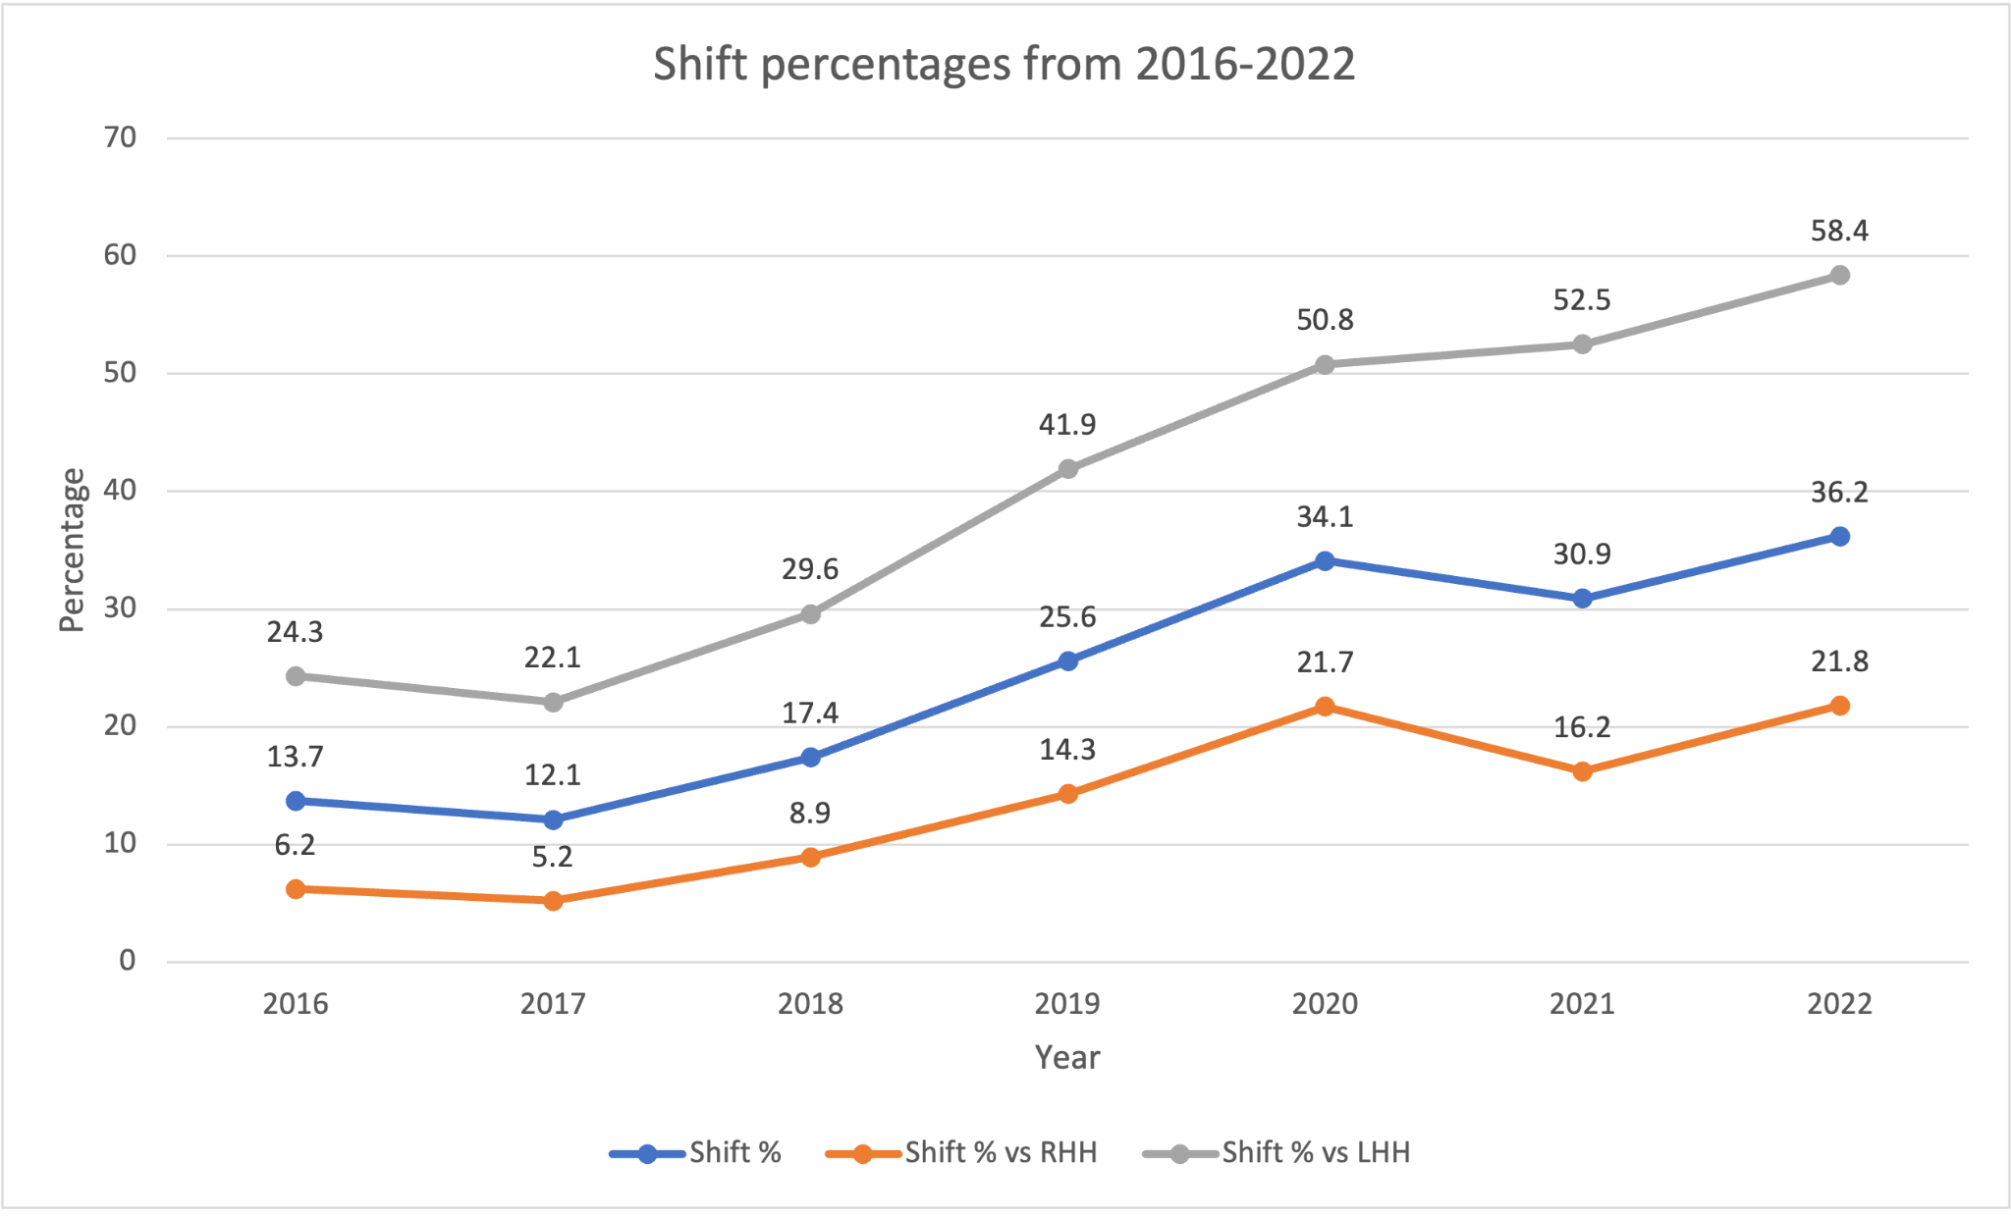
Shift percentages
Notes:
Shift percentages
One of my favorites because of how drastic it is.
A shift is when defenders position themselves on the field to where the hitter will most likely hit the ball according to their recent and cumulative spray charts and other stats.
Its most common for left handed hitters as the graph shows, this most likely has to do with lefties being more pull (hit the ball towards your side of the field L-RF, R-LF)happy cumulative
There is only clear data about this for a short period of time but its growing very fast. Already in 7 yeast there is a large influx in shifts in general but again more lefties.
The shift is one of the main culprits in making baseball more boring.
It dampens balls in play and doesn’t allow as many hits as there should be.
Takes away the opportunity for great fielders to shine and show of their athleticism or do their job.
The goal is to win and to do that you need to score runs and stop runs from being scored on you but this really hampers baseballs ability to be fun to watch.
Players aren’t necessarily losing their athleticism but the game is taking it out.

Slide 20
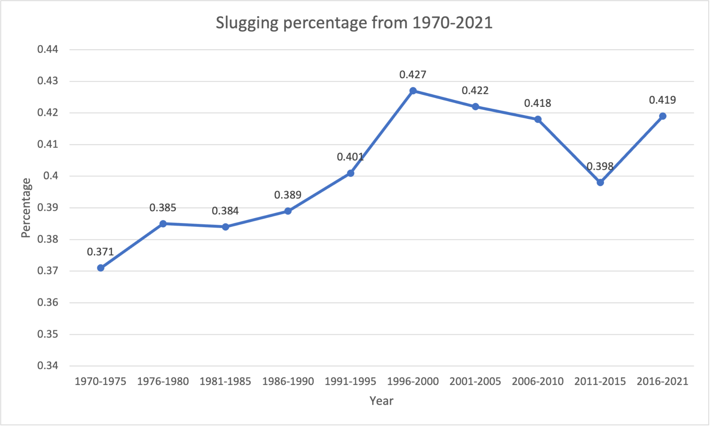
SLG %
Notes:
SLG %
SLG % is a measurement of all of a batter's extra base hits. (.400-.450 is pretty good, .450-.500 is very good. Above .500 is great and below .400 is not great)
SLG being similar to ISO shows a similar picture but SLG has some more inconsistencies.
Again there is a clear spike in the steroid era then a decline and back up.
THe interesting part is that ISO and HRs are higher now than they have ever been but SLG isn't. That could have to do with the fact that most SLG comes from HRs and not 2B and 3Bs.
At the moment SLG is down due to weird baseballs and supposedly the short spring training.
I'm sure it will continue to go back up but I think it won’t pass the previous peak as strongly as HRs or ISO did.

Slide 21
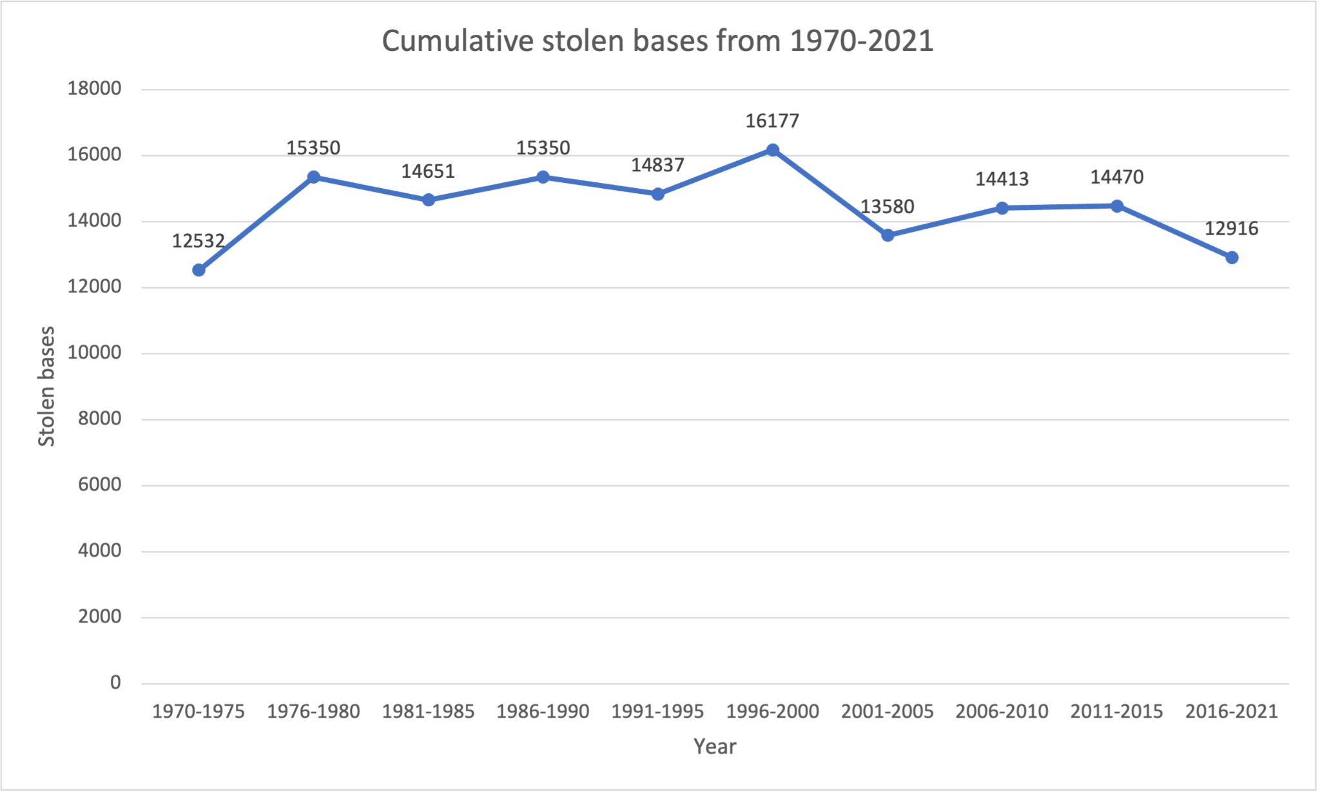
Cumulative stolen bases
Notes:
Cumulative stolen bases
As the game has evolved statistics showed that stealing bases wasn’t really viable anymore and wasn’t worth the risk.
It's obvious that having a runner on second is very good for a lot of reasons, negate a double play, easier to score off a single to the outfield from 2nd and distracts the pitcher.
But the higher potential to be tagged out and chance of injuring your hand mitigate the benefits of stealing bases.
There's a reason Mike Trout once led the league in stolen bases but now barely steals any, the injuries you could sustain in your fingers or hand from stealing bases can shutdown a player for a while and are the main cause to the decrease in stolen bases.
The graph peeks in the late 90s and the late 70s but has consistently gone down since then.
As of now the total is down a little more than 3000 SBs compared to the highest peak in the late 90s.

